Slide 1
Strategic Planning Vision Retreat

Slide 2
Welcome Superintendent
Who are we and what are we here to do?

Slide 3
FOUNDATION OF CONTINUOUS IMPROVEMENT
Pillars | Guiding Question
MISSION | What is our fundamental purpose; why do we exist?
VISION | What must we become in order to accomplish our fundamental purpose?
GOALS | How will we know if we are making a difference?
VALUES | How must we behave to achieve our mission, vision and goals?

Slide 4
Strategic Planning Process
Where do we want to be?
Where are we now?
How will we get to where we want to be?
What
are we learning?
Vision and
Mission
Needs
Assessment
Goal Setting
Action
Planning
Monitor
Adjust
Improve
Stakeholder Input/ Impacts
Defining Key Areas To Improve
Gap Analysis
SMART Goals
Strategies
Best Practice
Staff Development
Adjust
Structures &Processes
Review and Revise
Implement
Strategies
Implement
Strategies
Annual- Formative
Multi-Year: Summative

Slide 5
It is good to have an end to journey toward;
but it is the journey that matters in the end.
Ursula K. LeGuin 1999
WHERE DO WE WANT
TO BE?
HOW DO WE GET FROM
WHERE WE ARE TO
WHERE WE WANT TO BE?
WHERE ARE WE NOW?
CONTINUOUS IMPROVEMENT

Slide 6
"If schools are not imagining a different future, they will amplify their efforts to do what they have always done."
-Grant Lichtman, #EdJourney: A Roadmap to the Future of Education

Slide 7
COMMON VOCABULARY
Now I understand

Slide 8
The FOUR Pillars of a Strategic Plan
Mission
Who we are? Why do we exist?
Vision
What must we become?
Values
How must we behave?
Goals and Objectives
How we gauge our success?
Definitions
Connections
Criteria for Success

Slide 9
Strategic Plan Foundational Questions:
What business are we in and why? Mission, Vision, and Core Values
Where are we going? Long-Range Goals
What are the key issues that are urgent to address? Strategy
How will we know we are growing and improving? Key Indicators, measures, and targets

Slide 11
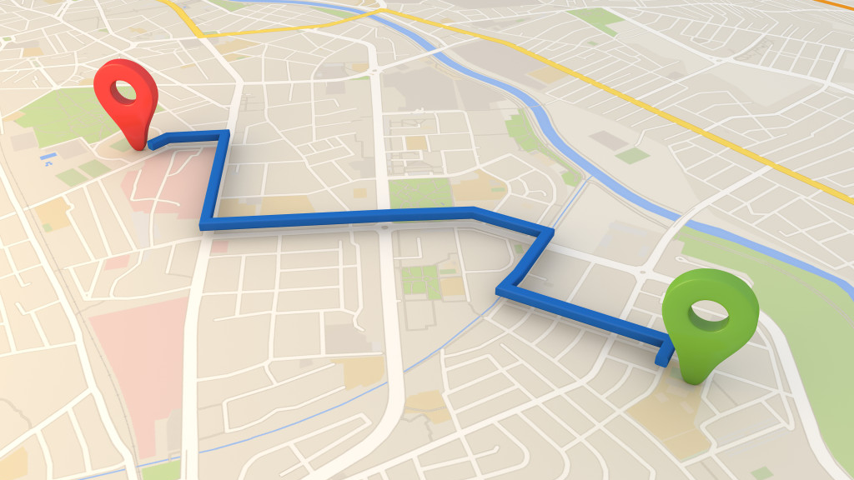
From where we are to where we want to be

Slide 12
MISSION
VISION
From where we are to where we want to be
CORE VALUES
Beliefs that guide our behaviors and actions

Slide 13
VISION RETREAT OUTCOMES
Answer the question “Where do we want to be? How will we look, sound, and feel differently 5 years down the road than we do today?”
Reflect on STAKEHOLDER FEEDBACK to revise our SWOT analysis from the Data Retreat.
Investigate schools and districts to identify practices and ideas to inform A PREFERRED FUTURE FOR THE DISTRICT.
Invent a PREFERRED FUTURE (Mission and Vision) to move the district to an even high level of performance.
Develop a set of CORE VALUES that will guide the actions and behaviors of the district as its works toward achieving its Preferred Future

Slide 14
How do we want to be different 5-10 years from now than we are today?
Mission
Vision
Core Values

Slide 15
ACTIVITY ONE: 40 minutes
Reflect on stakeholder feedback to revise our SWOT analysis from the Data Retreat
.

Slide 16
SWOT ANALYSIS
S TRENGTHS
W EAKNESSES
O PPORTUNITIES
T HREATS

Slide 17
Activity One Directions 45 min
Examine stakeholder feedback reports:
Look for themes
Add to the previous SWOT
Prioritize Top Ten
Strengths AND Opportunities Weaknesses AND Threats
40 minutes- Making Adjustments
5 minutes- Sharing

Slide 18
ACTIVITY TWO: 60 minutes Investigation 10 minutes break 60 minutes Reports
INVESTIGATE a Preferred Future: Electronically learn about some schools/districts who are inventing their future.
.

Slide 19
Activity Two: Table Assignments
INVESTIGATE a Preferred Future:
Electronically learn about some schools/districts who are inventing a 21st century approach to teaching and learning. Discover how their approach is similar or different to our current approach
INVESTIGATIONS:
List the site selected

Slide 20
Steps in the Process
Assign Team Roles
Timekeeper
Artist(s)
Presenter
Investigation Partners
Jigsaw the Essential Questions
Pairs or Triads
3 Questions
Investigate your Site
URLs: Videos
Key Concepts
Points of interest
What’s Different? What’s Intriguing?
Design your Poster
What do you want to share?
Use art supplies
Display what inspires you as you think of mission and vision

Slide 21
Activity Two Directions
Purpose | Non-Purpose
The purpose of the investigation is to stimulate strategic plan team thinking about a new district mission and vision that will incorporate ideas and concepts not currently in place. It will help the team describe a Preferred Future | The purpose of this investigation is NOT to find a site we most would like to emulate.
We will be looking across all investigations to create a unique hybrid mission and vision.

Slide 22
Investigation Guide
HOMEWORK ASSIGNMENT | FURTHER INVESTIGATION at the Vision Retreat:
Homework Assignment: View the video clip: Embracing and Realizing Future Learning Opportunities http://www.stonefields.school.nz/ Take a virtual tour https://sites.google.com/a/stonefields.school.nz/the-collaborative/resources | Learn about the school’s four vision principles. View the three student video clips. http://www.stonefields.school.nz/page/Vision/ Learn about the school’s philosophy of learning and how it keeps learning visible and aligned to student ownership. View the four clips about learning. http://www.stonefields.school.nz/page/Learning/ Check out the resources The learning process Learner qualities Defining our leadership work Value and Mindsets The Learning Pit https://sites.google.com/a/stonefields.school.nz/the-collaborative/resources-1 Click on the works below each graphic

Slide 23
Pairs/ Triads | Questions
First Pair or Triad | What are students doing that excites and inspires you? What are teachers doing that excites and inspires you? How might you define responsibility and accountability?
Second Pair or Triad | What does the structure look like that intrigues you: Schedule, time, day, year? How might you define: Use of space and learning opportunities anywhere, anytime, anyplace? How might you define: Use of technological tools?
Third Pair or Triad | How might you define: Rigor and relevant curriculum? How might you define: Assessment and student success/ What words describe the mission and vision of the site you investigated? Do they have core values? What are they?

Slide 24
Tell the story of your investigation through pictures and words. Answer the question: What were the most compelling ideas you learned about this investigation that you hope the district will learn more about through its strategic planning efforts? Be creative, use cut out materials, shapes, markers, tape, sticky glue, etc. to create your poster. Spend 15 minutes creating your poster.

Slide 25
Time | Task
5 minutes | Share your Site Investigation homework notes
30 minutes | Complete investigation in pairs or triads answering the investigation questions
15 minutes | Develop your key ideas to share
10 minutes | Prepare your poster
10 minutes | BREAK
10 minutes | Prepare your presentation and presenter
50 minutes 5 - 10-minute presentations | Conduct presentations

Slide 26
BREAK
Notes:
Time: 15 minutes

Slide 27
Activity Two: Hear Reports
Participate in a Gallery Walk
Rotate clockwise.
Hear others’ reports
10 minutes of Report/Q & A
Jot down key concepts you want to remember in your Participant Handout. What were the most compelling ideas you learned about this investigation that you hope the district will learn more about through its strategic planning efforts?

Slide 28
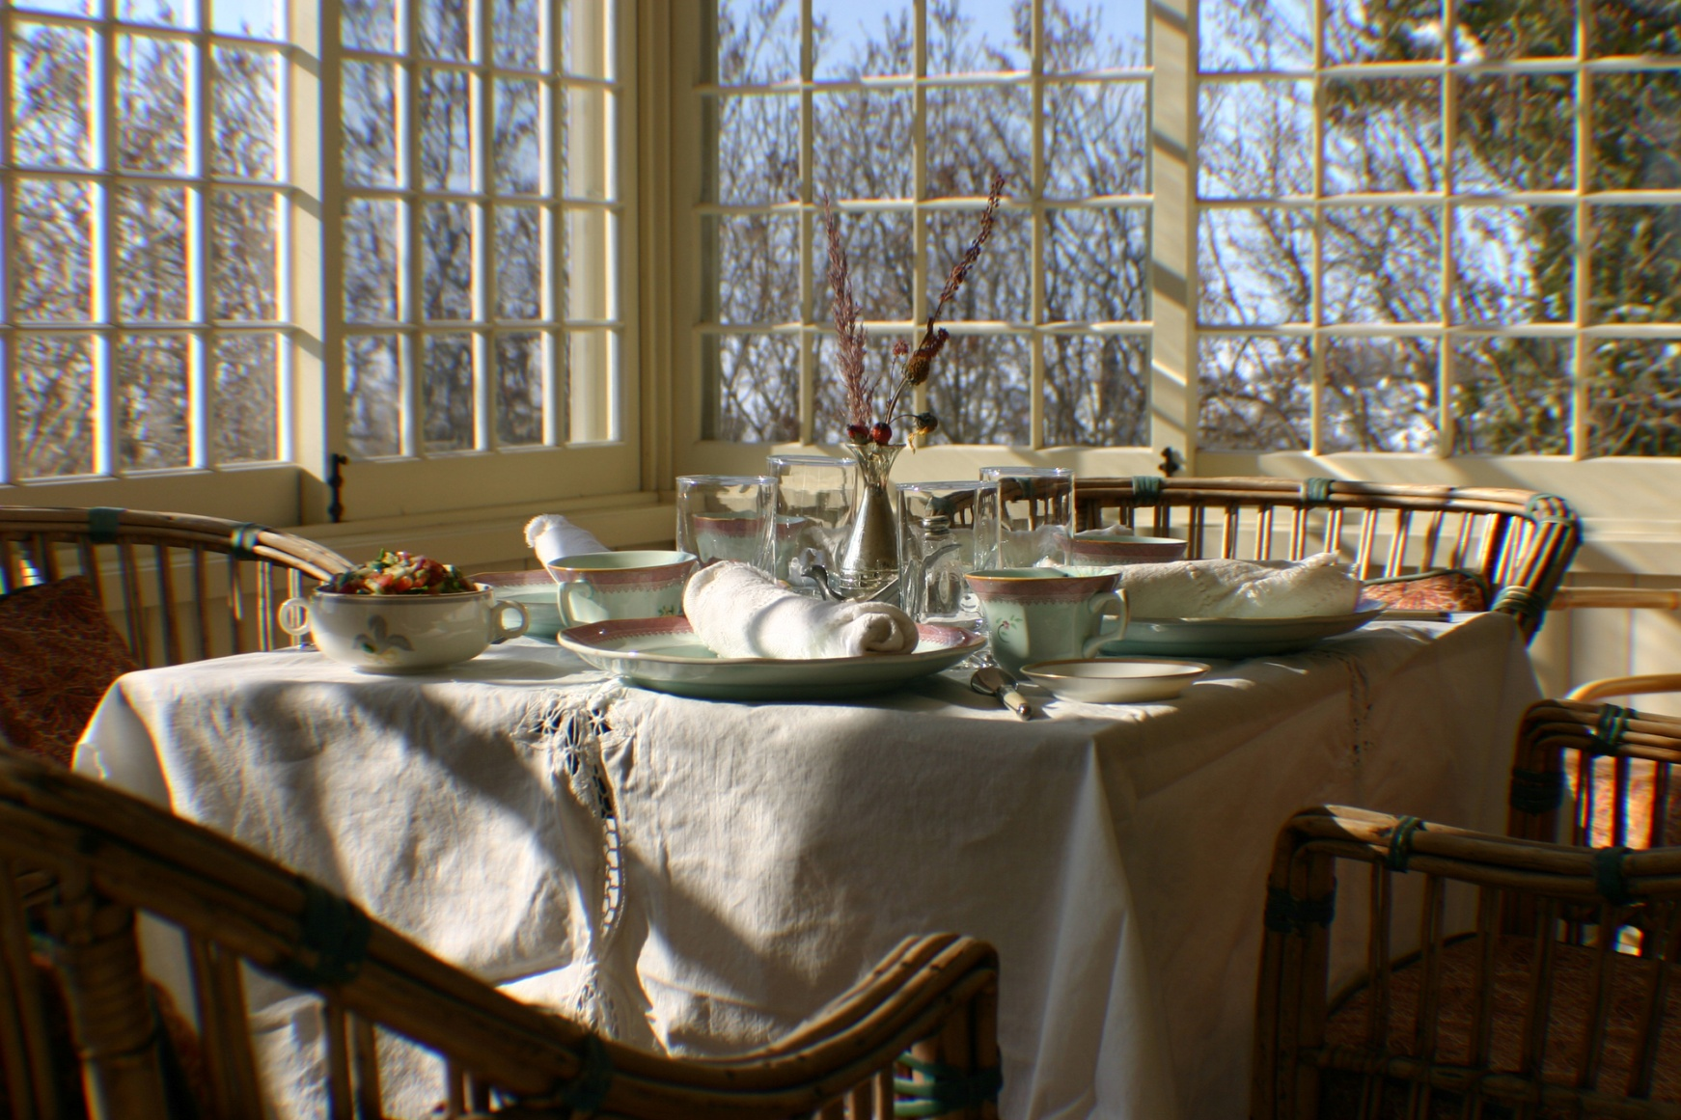
LUNCH
Notes:
Time: 12:00 -12:30
Purpose: Indicates lunch time
Lecture Notes:
Activity Notes: Play music or use timer (optional). Sound the reminder, 5 minutes before returning.
Resources Required:
Audience Reaction:

Slide 29
ACTIVITY THREE: Invent a Preferred Future as a result of your investigation. 120 minutes
Invent a PREFERRED FUTURE (Mission and Vision to move the district to an even high level of performance.
Foundation
Mission
Vision
Values/Commitments
.

Slide 30
Illinois Vision 2020
Mission: Public education must play a defining role in ensuring equal opportunity for learning.
Vision: It is our collective duty to do all we can to guarantee every student, no matter his or her demographic or geographic identity, has equal access to a quality education. We will do this through the following priorities:
21st Century Learning
Highly Effective Educators
Shared Accountability
Equitable and Adequate Funding

Slide 31
21st Century Learning
For success in life, students need more than knowledge of math and reading. It is time to expand the definition of student learning, commit to the development of the “whole child,” and invest in policies proven to link all schools to 21st century learning tools.

Slide 32
Highly Effective Educators
The quality of teachers and school leaders is the greatest predictor of student achievement schools can influence. By attracting, developing, and retaining our state’s best educators, we can have a profound impact on student learning.

Slide 33
Shared Accountability
A quality education for all Illinois students cannot be ensured without the collaboration, compromise, and hard work of both educators and legislators. With that in mind, it is necessary to expand educator responsibility in the legislative process, create a shared accountability model, and restructure mandates to allow more local district flexibility.

Slide 34
Equitable and Adequate Funding
All students in Illinois are entitled to a quality education. It is our duty to ensure our students have access to all necessary resources by improving equity in the funding model, appropriating adequate dollars for education, and allowing local school districts the autonomy needed to increase efficiency.

Slide 35
Core Values
Vision 2020 is based on the following Core Values
High Expectations and Quality
Shared Accountability
Innovation
Equity
Transparency
Continuous Improvement
Partnerships

Slide 36
The words of mission and vision statements are not worth the paper they are written on unless people begin to do something differently.

Slide 37
VISION AND MISSION
MISSION: The mission pillar asked the question, “WHY?” More specifically, it asks “Why do we Exist?” The intent of this question is to help reach agreement regarding the fundamental purpose of the organization. This clarity of purpose can help establish priorities and becomes an important factor to guide decisions.”
(DuFour, DuFour, Eaker, and Many, Learning By Doing, Second Edition: Solution-Tree, 2010)

Slide 38
VISION AND MISSION
VISION: The vision pillar asks “What?”—that is, “What must we become in order to accomplish our fundamental purpose?” In pursuing this question, the district attempts to create a compelling, attractive, realistic future that describes what they hope their district will become. Vision provides a sense of direction and a basis for assessing both the currently reality of the district and potential strategies, programs, and procedures to improve upon that reality.
(DuFour, DuFour, Eaker, and Many, Learning By Doing, Second Edition: Solution-Tree, 2010)

Slide 39
Vision REFLECTS what the MISSION would look like if it were fully achieved.

Slide 40
CORE VALUES
CORE VALUES: The values pillar asks “How must we behave?”—that is, “What beliefs must we all share to achieve our mission and vision?” In pursuing this question, the district attempts to clarity commitments everyone must share and be responsible and accountable for to move the district forward to. Core values are few in number, easy to remember, be guiding principles defining a code of conduct and behavior.
(DuFour, DuFour, Eaker, and Many, Learning By Doing, Second Edition: Solution-Tree, 2010)

Slide 41
Activity Three Directions
Read about what makes great mission, vision, and core value statements.
Discuss with your team what you learned from your investigations that might inform a new mission, vision and values statement
Write a new statement
Review current Mission, Vision and Values
Review the criteria for what makes a good mission and vision
Write your ideas for a new mission, vision and values

Slide 42
Activity Three Directions
REVISE the current mission and vision statements to better address the criterion and to describe the Preferred Future of the District
CONSIDER your investigations, examples and articles read.
Current | Criteria | New

Slide 43
Live a mission and vision deeply informed by new contexts for learning.
10 Principles for Reimagining Today’s Schools.
KEY QUESTIONS
Why do we exist as a school?
What is our central value in the lives of students and in our communities?
When they leave us, what will our students need to be able to do and what kind of people will they be?
What practices and conditions in classrooms, schools, and communities are required for your students to reach those outcomes?

Slide 44
Have clearly articulated and shared beliefs about learning that are lived in every classroom.
10 Principles for Reimagining Today’s Schools.
KEY QUESTIONS
How do children and adults learn most powerfully and deeply in their lives?
What conditions are required for learning?
How must we all behave and act to maximize student growth and achievement
What do we value that is non-negotiable?
How do our beliefs drive every decision we make in our school?

Slide 45
Embrace and anticipate constant change and evolution.
10 Principles for Reimagining Today’s Schools.
KEY QUESTIONS
How are teachers and students engaged in ongoing research and development about their work?
How do we ensure continuous growth and improvement?
Is there a culture that supports innovation and trying new things?
Do we foster the 6 C’s: character education, citizenship, collaboration, communication, creativity, and critical thinking.
Are we making good use of time and space?

Slide 46
Activity Three Directions- Mission
Words
Phrases
Sentence

Slide 47
Activity Three Directions- Vision
Component
Vision
Component
Component

Slide 48
Activity Three Directions- Core Values
Mission
Preferred Future
Vision
What beliefs must we all share to achieve our Mission and Vision?
Values

Slide 50
Setting Direction Retreat
Seek Feedback
Review the Feedback
Revised Preferred Future Statement
Consider Long-Range Goals
Provide feedback to Goal Indicators and measures
Determine high leverage strategies to focus priority work for next 3-4 years.
DATE:
TIME:
Thanks for a great day!

